Slide 1


FINGERPRINT DOOR LOCK SYSTEM
GOLF research
By
Shubham Musmade
Raaj Singh Rawat
Ritesh ojha
Pallavi kumari

Slide 2
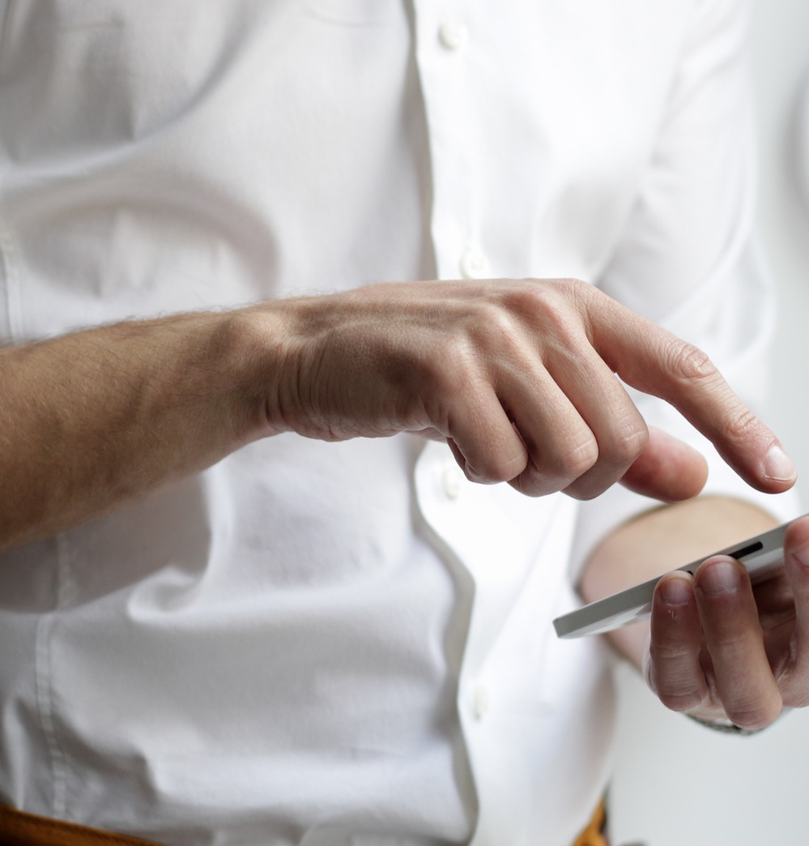
Our Customer Review
According to the customers point of view
They need best privacy
Unbreakable Locks
Open with owners permission
Best for private office
The Project is totally based on customer review. According to there needs
GOLF
research

Slide 3

Our Vision
Project Functions
Fast access
Pin code access
Open with fingerprint
Up to 100 person can enter
Highly secure
GOLF
research

Slide 4

Some advantages of fingerprint door lock system
1. Security Based on Fingerprints
2. Eliminates Problem Of Lost Keys 3. More Secure Than Traditional Locks
4. Makes Employee Management Easier
5. More Economical In the Long Run
GOLF
research

Slide 5

Why did we choose this topic
Automatically shuts the door when you leave
Keyless biometric scanner
Increased control over visitors
Maximum security
Fast access
Temper proof
GOLF
research

Slide 6

Material for our Project
Arduino Uno
Fingerprint sensor module
12c LCD display
Door lock
Relay module
7-12v power source
Jumper cables
Keypad
buzzer
GOLF
research

Slide 7
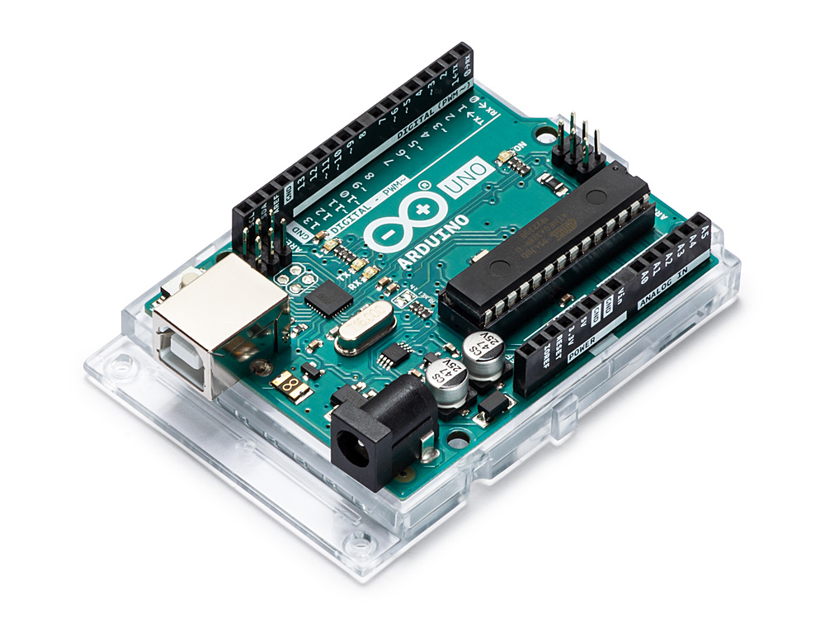
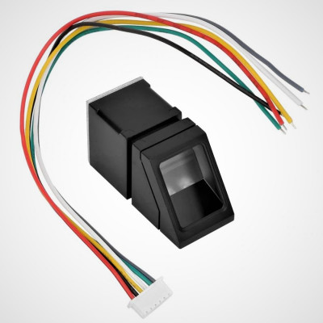
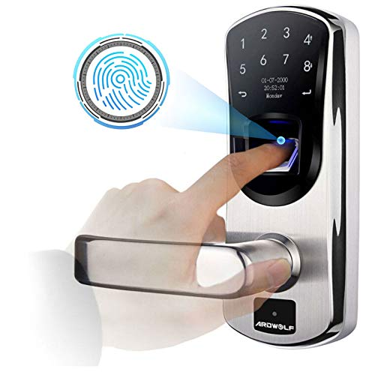
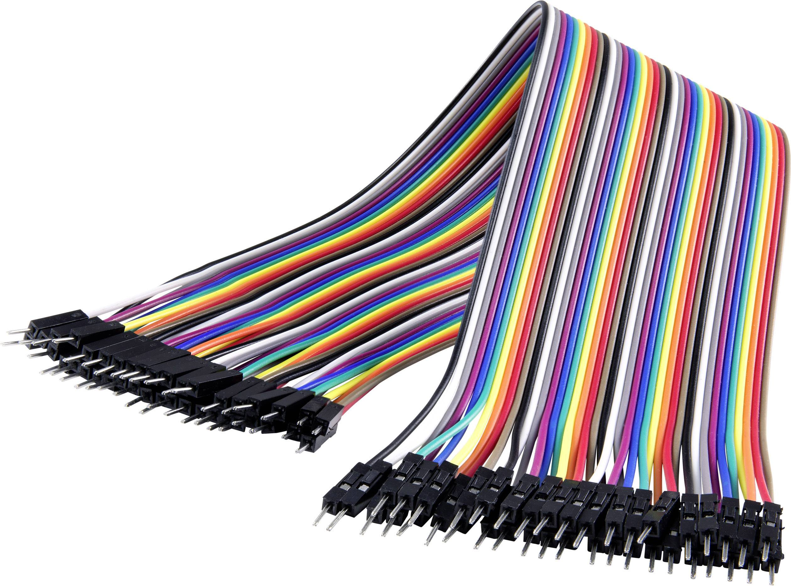
Features of component
Arduino- These are able to read input – light on a sensor, a finger on button and turn it into an output – activating a motor or turning on Led
Finger print sensor module- It is used a way to verify identity. This module has rich command set for operating function such as to enrol/verify/fingerprint, read/write fingerprint template file, get fingerprint image and so on.
Door lock- Basically fingerprint locks operate by scanning and converting your fingerprint data into a numerical template.
Jumper cable- These are kind of mini extension.
GOLF
research

Slide 8
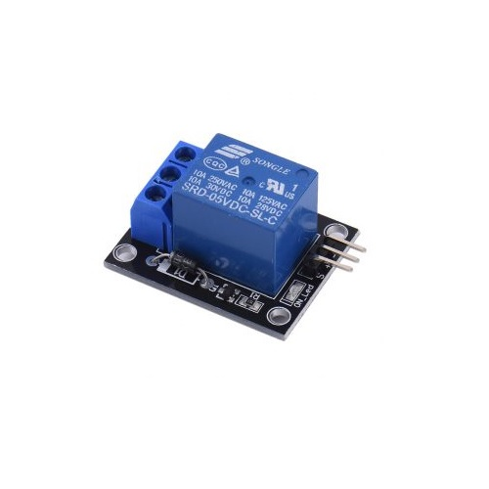
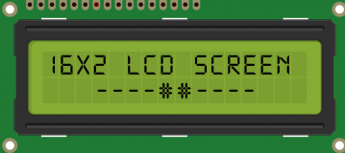
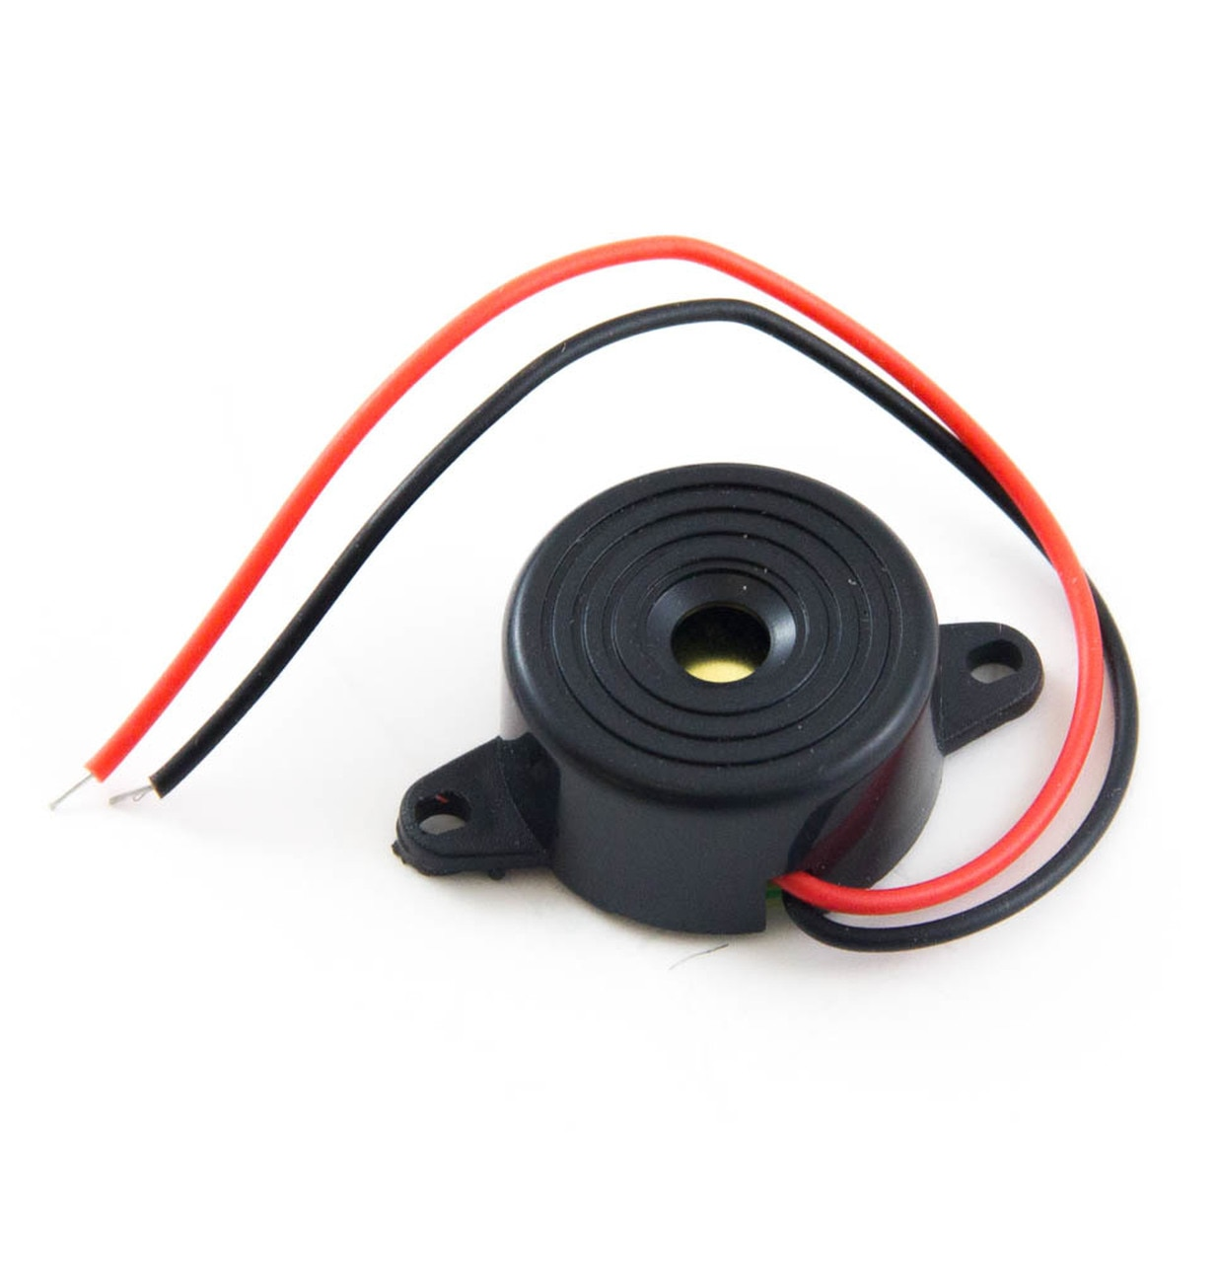
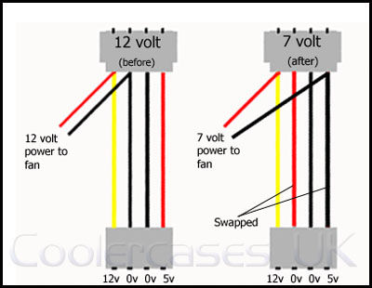
Relay module- These are switches that open and close circuits electromechanically or electronically
12 LCD display- It is an easy to use display module.
Buzzer- It is on Arduino signalling device
7-12v power source – They are regulate the output using a dissipative regulating circuit. They were extremely stable and have very low ripple.
GOLF
research

Slide 9
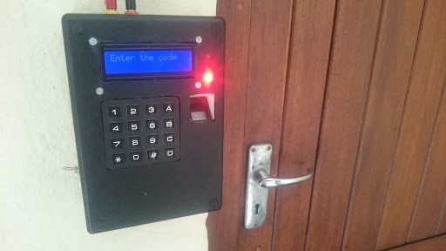
How it is going to work
The user puts their hand on the finger print sensor.
Then the optical sensor scans the fingerprint as an analogue data, then sends it to the ADC.
The ADC will convert the data into digital data and send it to the microprocessor.
The microprocessor will verify the data according to the data saved on the storage system.
After verifying that the person being scanned is authorized to the enter the area, the mechanized lock will open.
Then the user has to turn the knob and open the door.
The door will lock itself up after the user is inside the room.
GOLF
research

Slide 10
GOLF
research

